Slide 1
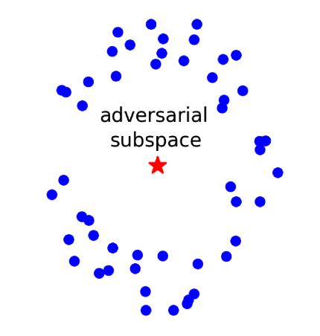
Adversarial Example Detection
姜育刚，马兴军，吴祖煊

Slide 2

Recap: week 3
1. Adversarial Examples
2. Adversarial Attacks
3. Adversarial Vulnerability Understanding

Slide 3
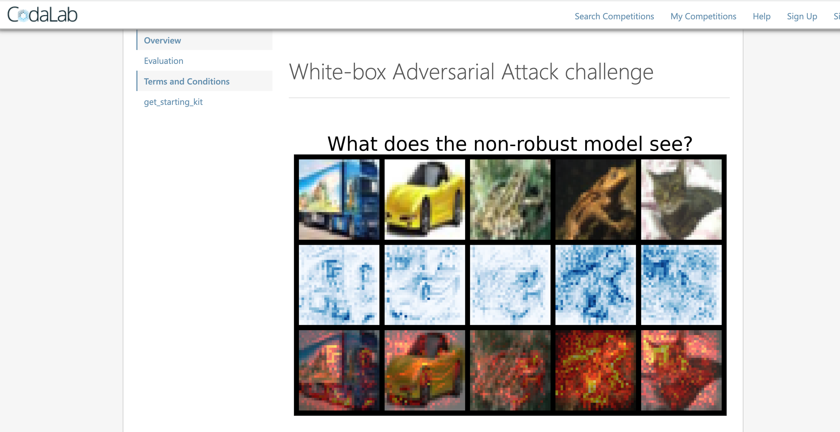
In-class Adversarial Attack Competition
https://codalab.lisn.upsaclay.fr/competitions/15669?secret_key=77cb8986-d5bd-4009-82f0-7dde2e819ff8

Slide 4
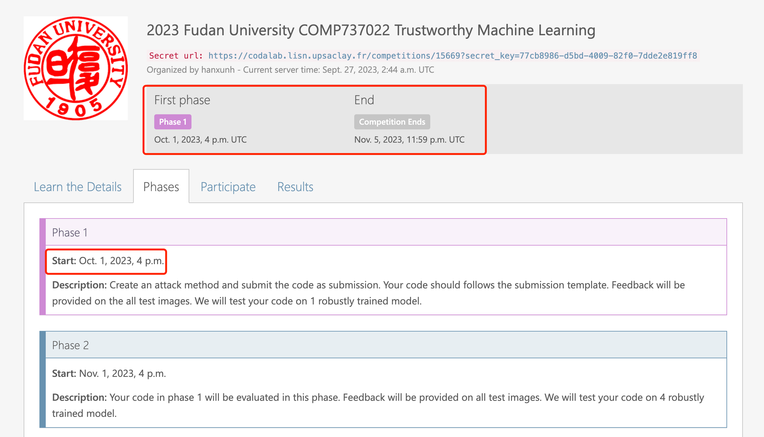
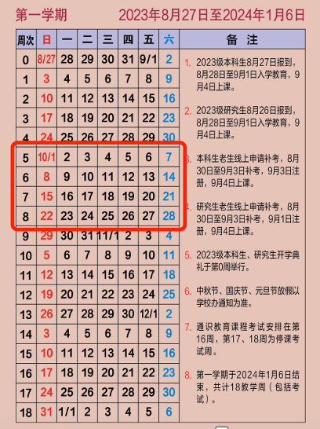
In-class Adversarial Attack Competition

Slide 5
In-class Adversarial Attack Competition
Adversarial attack competition （account for 30%）
必须使用学校邮箱注册比赛（否则无成绩）
比赛时间：
Phase 1： 10月1号 – 10月28号
Phase 2：评估阶段，学生不参与
按排名算分：
第一名30分
最后一名15分
没卡的同学可以使用Google Colab：https://colab.research.google.com/

Slide 6
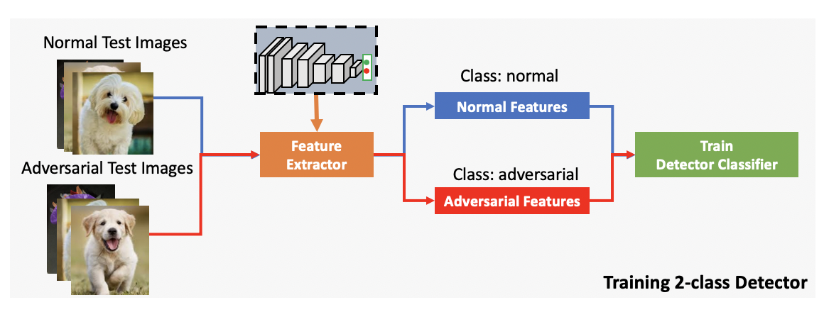
Adversarial Example Detection (AED)
A binary classification problem: clean (y=0) or adv (y=1)?
An anomaly detection problem: benign (y=0) or abnormal (y=1)?

Slide 7
Principles for AED
All binary classification methods can be applied for AED

Slide 8
Principles for AED
All anomaly detection methods can be applied for AED

Slide 9
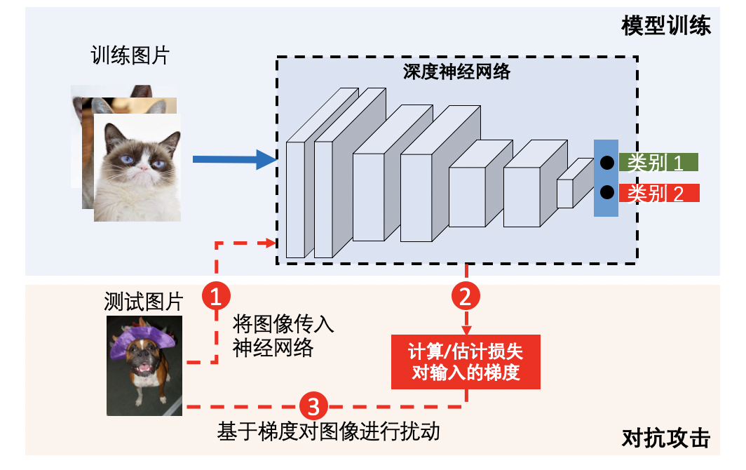
Principles for AED
Input statistics
Manual features
Training data
Attention map
Transformation
Mixup
Denoising
…
Activations
Deep features
Probabilities
Logits
Gradients
Loss landscape
Uncertainty
…
Use as much information as you can

Slide 10





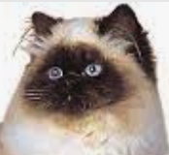


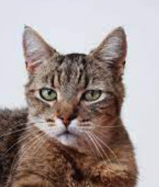



Principles for AED
Twins
Strangers
Extremely close to the clean sample
Far away in prediction
Leverage unique characteristics of adversarial examples

Slide 11
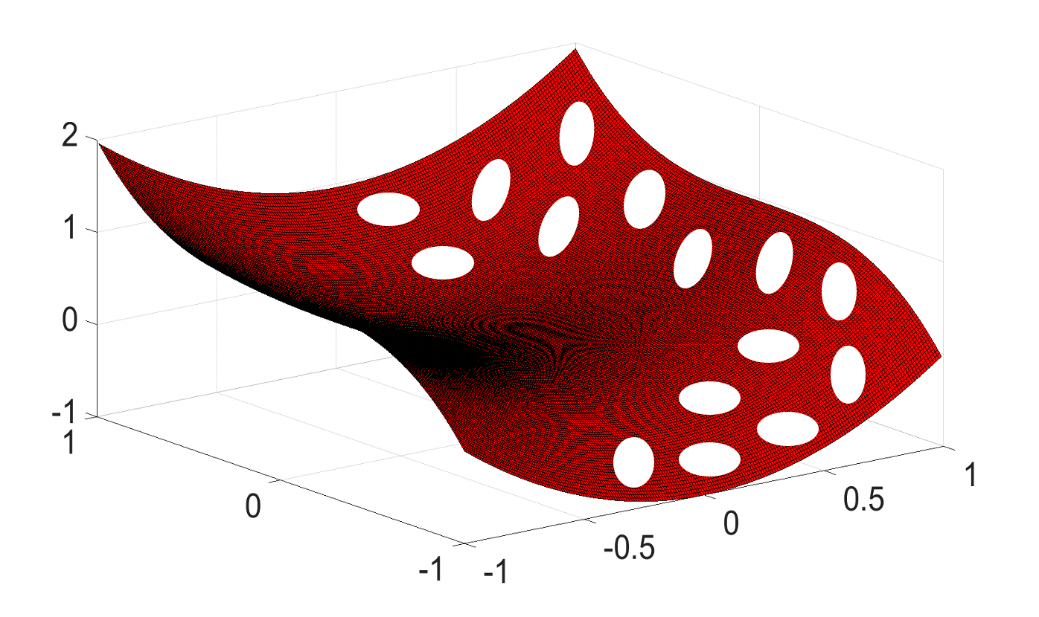
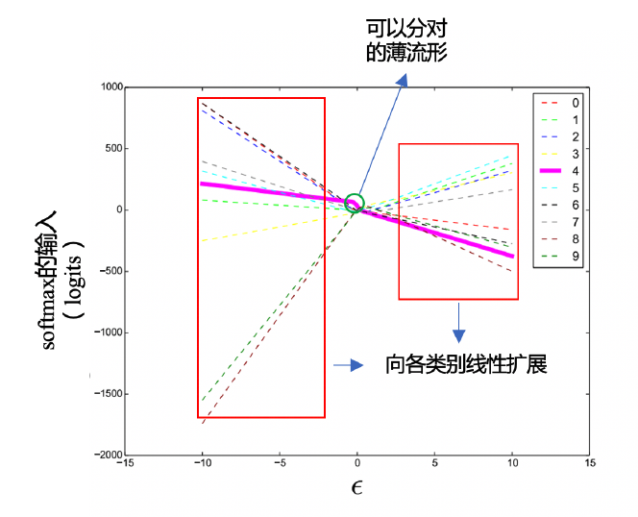
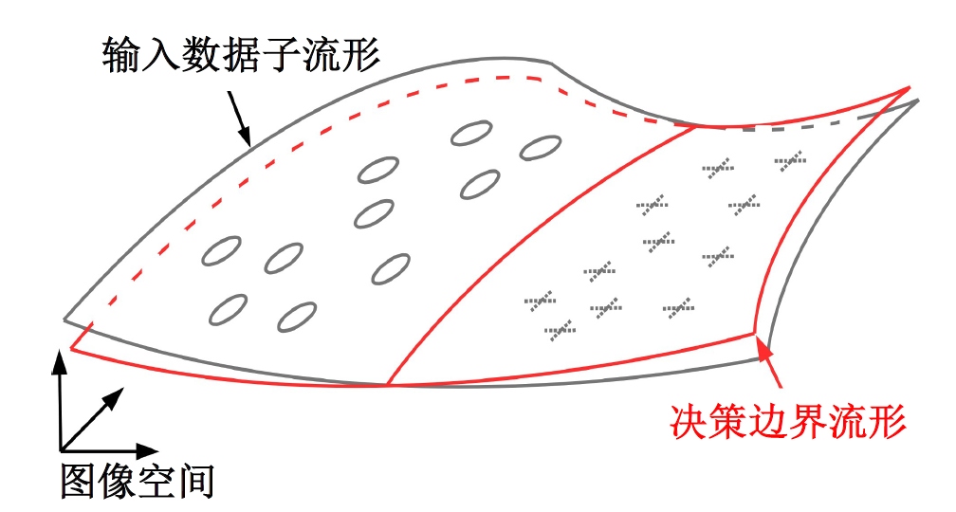
Principles for AED
High dimensional pockets
Local linearity
Tilting boundary
Build detectors based on existing understandings

Slide 12
Principles for AED
It’s is still feature engineering!

Slide 13
Challenges in AED
The diversity of adversarial examples used for training the detectors determine the detection performance
Detectors are also machine learning models: they are also vulnerable to adversarial attacks
The detectors need to detect both existing and unknown attacks
The detectors need to be robust to adaptive attacks

Slide 14
Existing Methods
Secondary Classification Methods (二级分类法)
Principle Component Analysis (主成分分析法，PCA)
Distribution Detection Methods (分布检测法)
Prediction Inconsistency (预测不一致性)
Reconstruction Inconsistency (重建不一致性)
Trapping Based Detection (诱捕检测法)

Slide 15
Existing Methods
Secondary Classification Methods (二级分类法)
Principle Component Analysis (主成分分析法，PCA)
Distribution Detection Methods (分布检测法)
Prediction Inconsistency (预测不一致性)
Reconstruction Inconsistency (重建不一致性)
Trapping Based Detection (诱捕检测法)

Slide 16
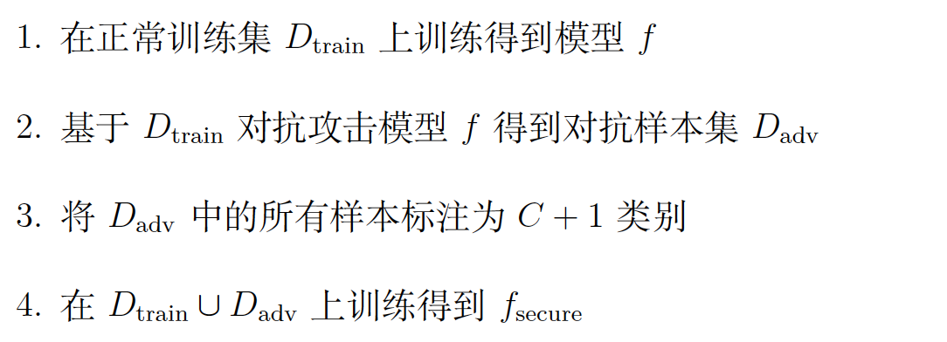
Secondary Classification Methods
Adversarial Retraining (对抗重训练)
Take adversarial examples as a new class
Grosse et al. On the (Statistical) Detection of Adversarial Examples, arXiv:1702.06280

Slide 17
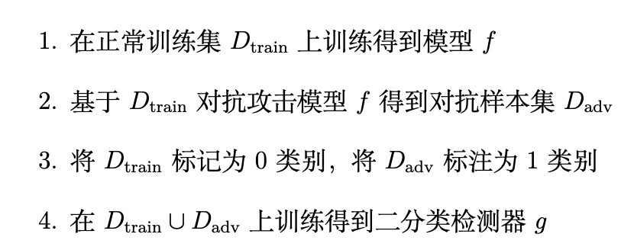
Secondary Classification Methods
Adversarial Classification (对抗分类)
Clean samples as class 0, adversarial as class 1
Gong et al. Adversarial and clean data are not twins, arXiv:1704.04960

Slide 18
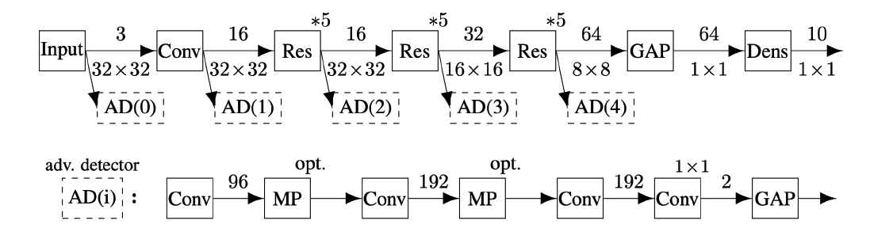
Secondary Classification Methods
Cascade Classifiers (级联分类器)
Training a detector for each intermediate layer
Metzen, Jan Hendrik, et al. "On detecting adversarial perturbations." arXiv preprint arXiv:1702.04267 (2017).

Slide 19
Existing Methods
Secondary Classification Methods (二级分类法)
Principle Component Analysis (主成分分析法，PCA)
Distribution Detection Methods (分布检测法)
Prediction Inconsistency (预测不一致性)
Reconstruction Inconsistency (重建不一致性)
Trapping Based Detection (诱捕检测法)

Slide 20
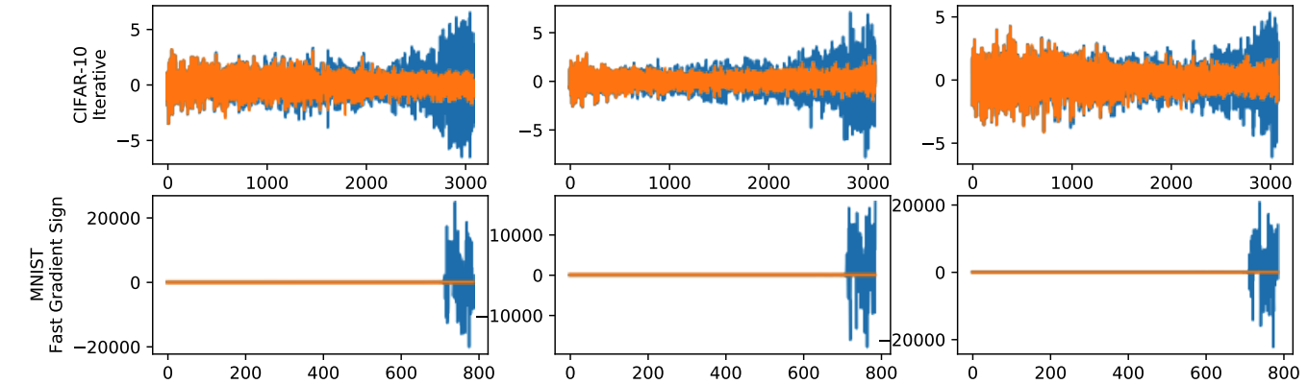
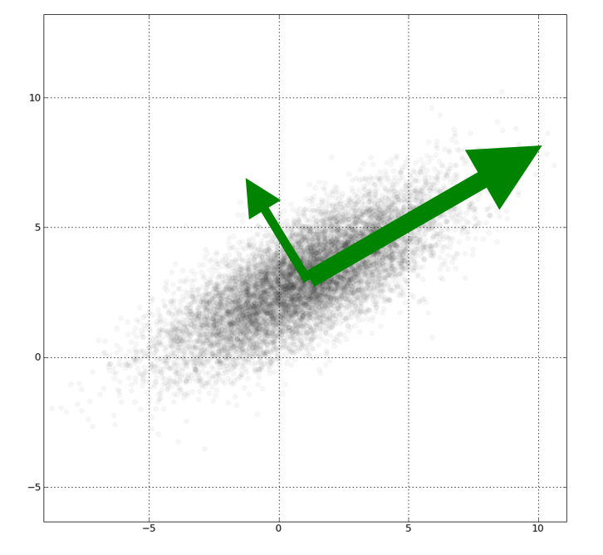
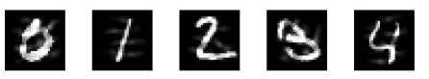
Principle Component Analysis (PCA)
Blue: a clean sample
Yellow: an adv example
An artifact caused by the black background
The last few components differentiate adversarial examples
Hendrycks, Dan, and Kevin Gimpel. “Early methods for detecting adversarial images.” arXiv:1608.00530 (2016); Carlini and Wagner. "Adversarial examples are not easily detected: Bypassing ten detection methods." AISec. 2017.

Slide 21
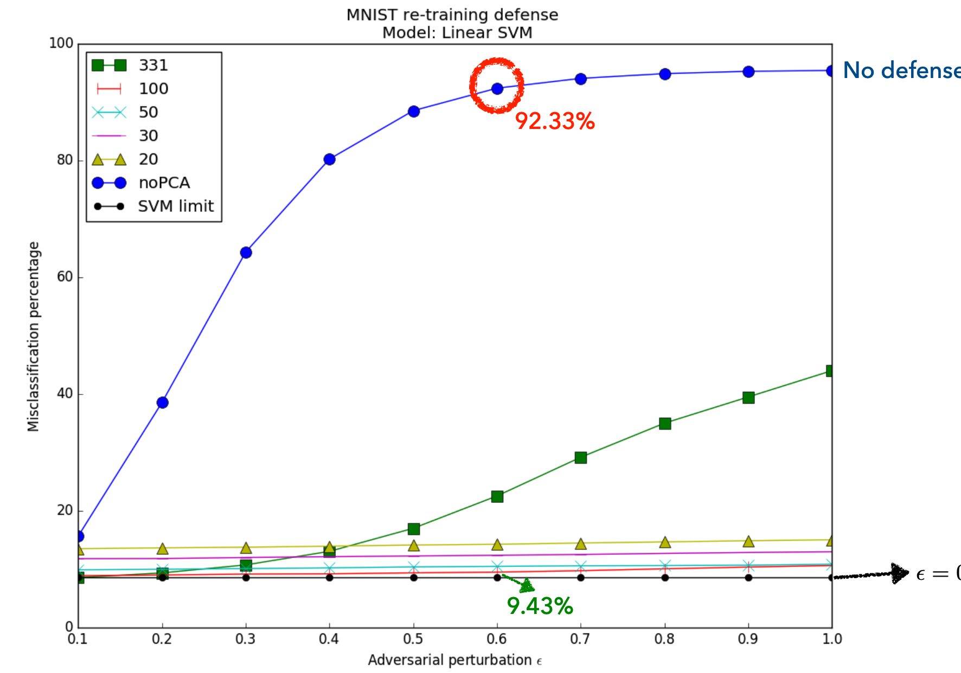
Dimensionality Reduction
Train on PCA reduced data
Bhagoji, Arjun Nitin, Daniel Cullina, and Prateek Mittal. "Dimensionality reduction as a defense against evasion attacks on machine learning classifiers." arXiv:1704.02654 2.1 (2017).

Slide 22
Existing Methods
Secondary Classification Methods (二级分类法)
Principle Component Analysis (主成分分析法，PCA)
Distribution Detection Methods (分布检测法)
Prediction Inconsistency (预测不一致性)
Reconstruction Inconsistency (重建不一致性)
Trapping Based Detection (诱捕检测法)

Slide 23
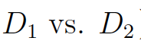
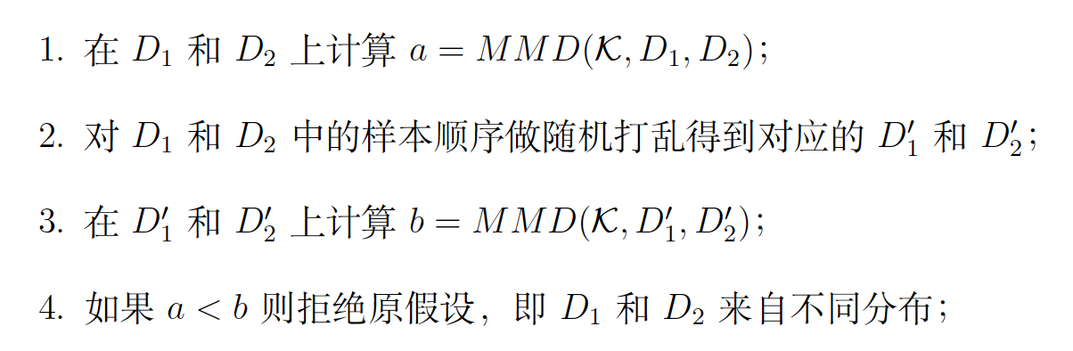
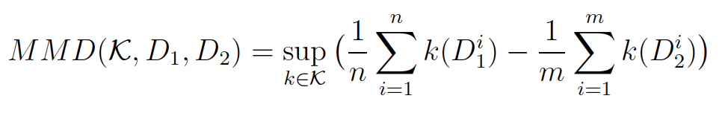
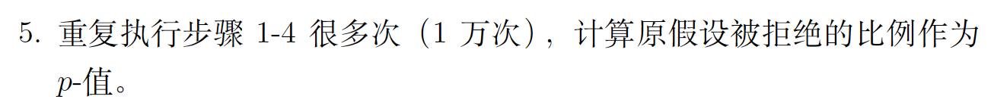
Distribution Detection
Maximum Mean Discrepancy (MMD)
Two datasets:
Grosse et al. On the (Statistical) Detection of Adversarial Examples, arXiv:1702.06280

Slide 24
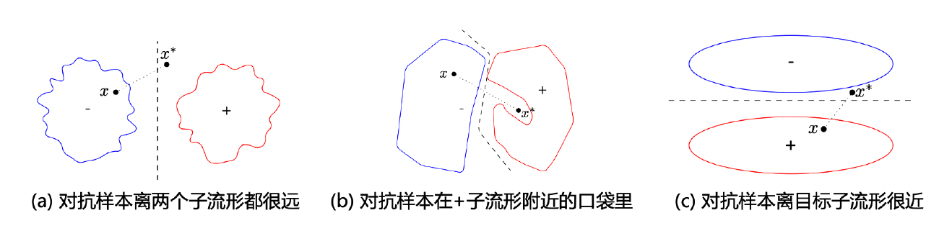
Distribution Detection
Kernel Density Estimation (KDE)
Adversarial examples are in low density space
Feinman, Reuben, et al. "Detecting adversarial samples from artifacts." arXiv preprint arXiv:1703.00410 (2017).

Slide 25
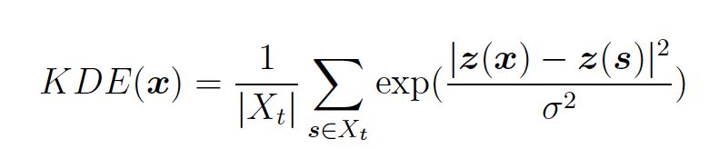
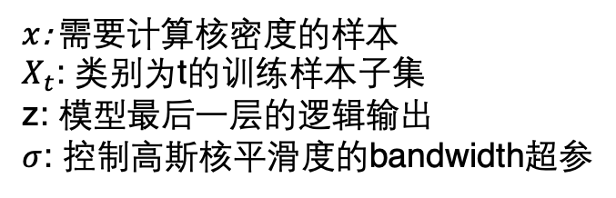
Distribution Detection
Kernel Density Estimation (KDE)
$x$: 需要计算核密度的样本
$X_{t}$: 类别为t的训练样本子集
z: 模型最后一层的逻辑输出
$σ$: 控制高斯核平滑度的bandwidth超参
Adversarial examples are in low density space
Feinman, Reuben, et al. "Detecting adversarial samples from artifacts." arXiv preprint arXiv:1703.00410 (2017).

Slide 26

Bypassing 10 Detection Methods
Adversarial Examples Are Not Easily Detected: Bypassing Ten Detection Methods. Carlini and Wagner, AISec 2017.

Slide 27
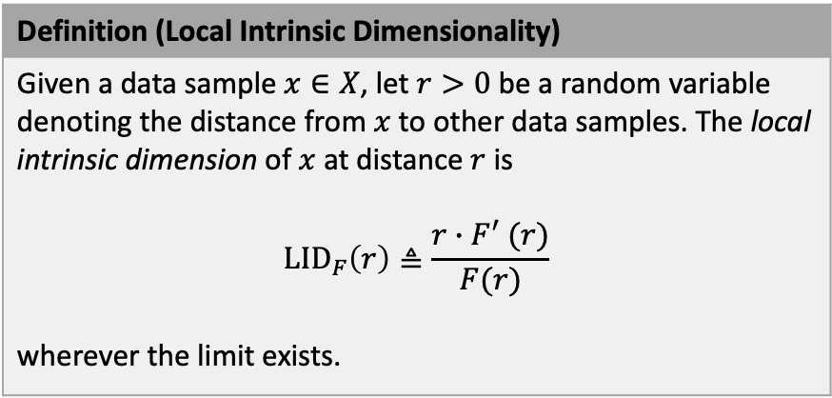
Local Intrinsic Dimensionality (LID)
Definition (Local Intrinsic Dimensionality)
Given a data sample $x∈X$, let $r>0$ be a random variable denoting the distance from $x$ to other data samples. The local intrinsic dimension of $x$ at distance $r$ is $${LID}_{F}\left(r\right)≜\frac{r∙F^{′} (r)}{F(r)}$$ wherever the limit exists.
Adversarial examples are in high dimensional subspaces
Characterizing Adversarial Subspace Using Local Intrinsic Dimensionality. Ma et al. ICLR 2018

Slide 28
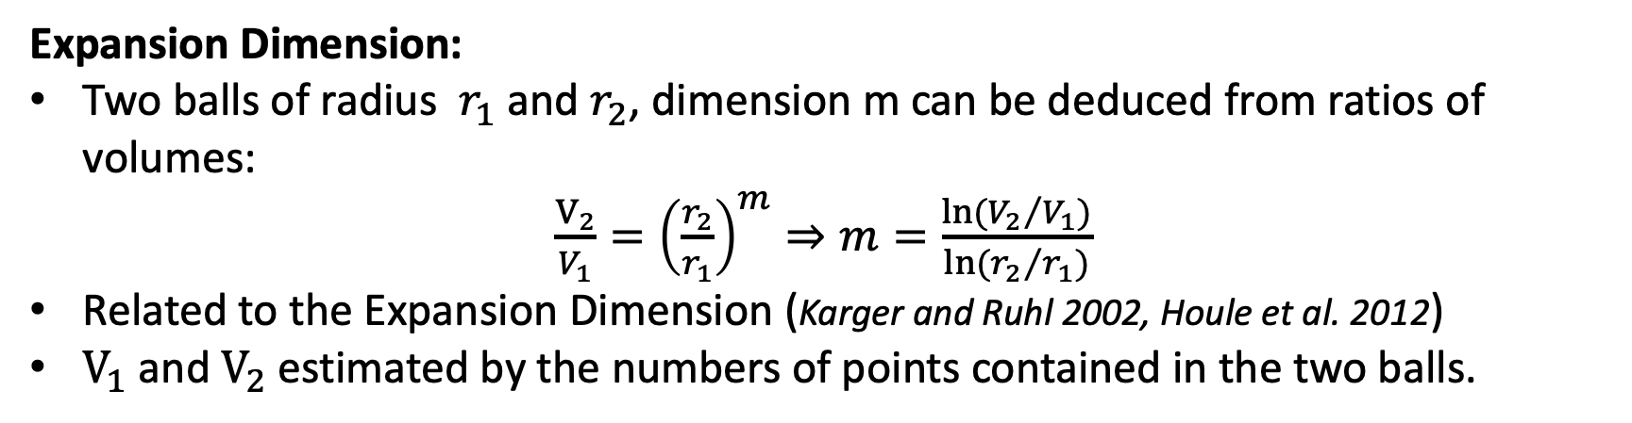
Local Intrinsic Dimensionality (LID)
Adversarial Subspaces and Expansion Dimension:
Expansion Dimension:
Two balls of radius $r_{1}$ and $r_{2}$, dimension m can be deduced from ratios of volumes:
$\frac{V_{2}}{V_{1}}={\left(\frac{r_{2}}{r_{1}}\right)}^{m}⇒m=\frac{\ln{{{(V}_{2}}/{V_{1})}}}{\ln{{{(r}_{2}}/{r_{1})}}}$
Related to the Expansion Dimension (Karger and Ruhl 2002, Houle et al. 2012)
$V_{1}$ and $V_{2}$ estimated by the numbers of points contained in the two balls.
Characterizing Adversarial Subspace Using Local Intrinsic Dimensionality. Ma et al. ICLR 2018

Slide 29
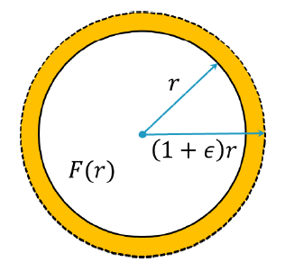
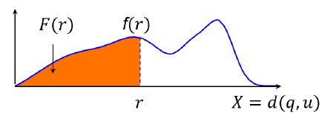
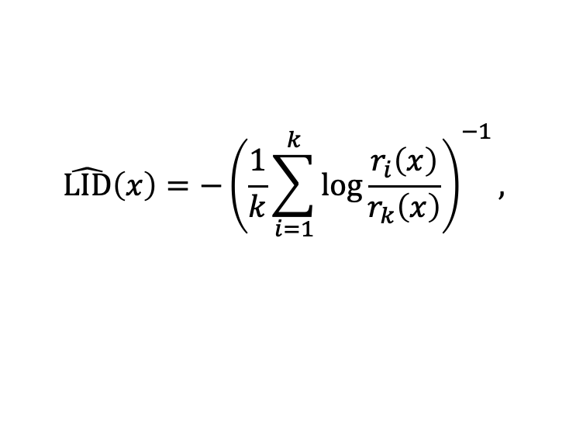
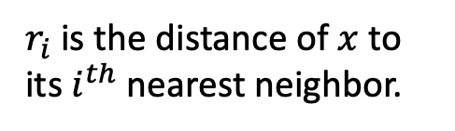
Local Intrinsic Dimensionality (LID)
Estimation of LID:
Hill (MLE) estimator (Hill 1975, Amsaleg et al. 2015):
$$\hat{LID}\left(x\right)=−{\left(\frac{1}{k}\sum_{i=1}^{k}{\log{\frac{r_{i}\left(x\right)}{r_{k}\left(x\right)}}}\right)}^{−1},$$
$r_{i}$ is the distance of $x$ to its $i^{th}$ nearest neighbor.
Based on Extreme Value Theory:
Nearest neighbor distances are extreme events.
Lower tail distribution follows Generalized Pareto Distribution (GPD).
Characterizing Adversarial Subspace Using Local Intrinsic Dimensionality. Ma et al. ICLR 2018
Estimating local intrinsic dimensionality. Amsaleg et al. KDD 2015

Slide 30
Local Intrinsic Dimensionality (LID)
Interpretation of LID for Adversarial Subspaces:
LID directly measures expansion rate of local distance distributions.
The expansion of adversarial subspace is higher than normal data subspace.
LID assesses the space-filling capability of the subspace, based on the distance distribution of the example to its neighbors.
Characterizing Adversarial Subspace Using Local Intrinsic Dimensionality. Ma et al. ICLR 2018

Slide 31
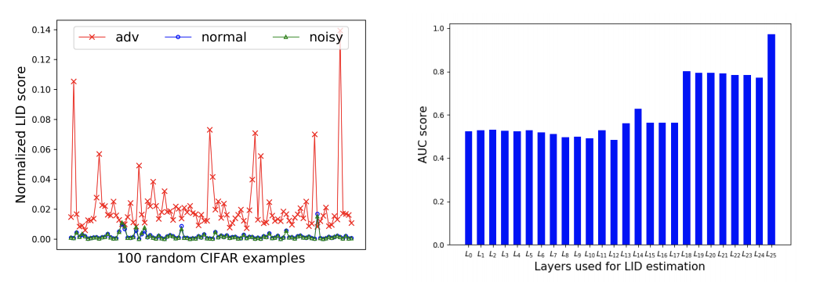
Local Intrinsic Dimensionality (LID)
LID of adversarial examples (red) are higher
LID at deeper layers are more differentiable
Characterizing Adversarial Subspace Using Local Intrinsic Dimensionality. Ma et al. ICLR 2018

Slide 32
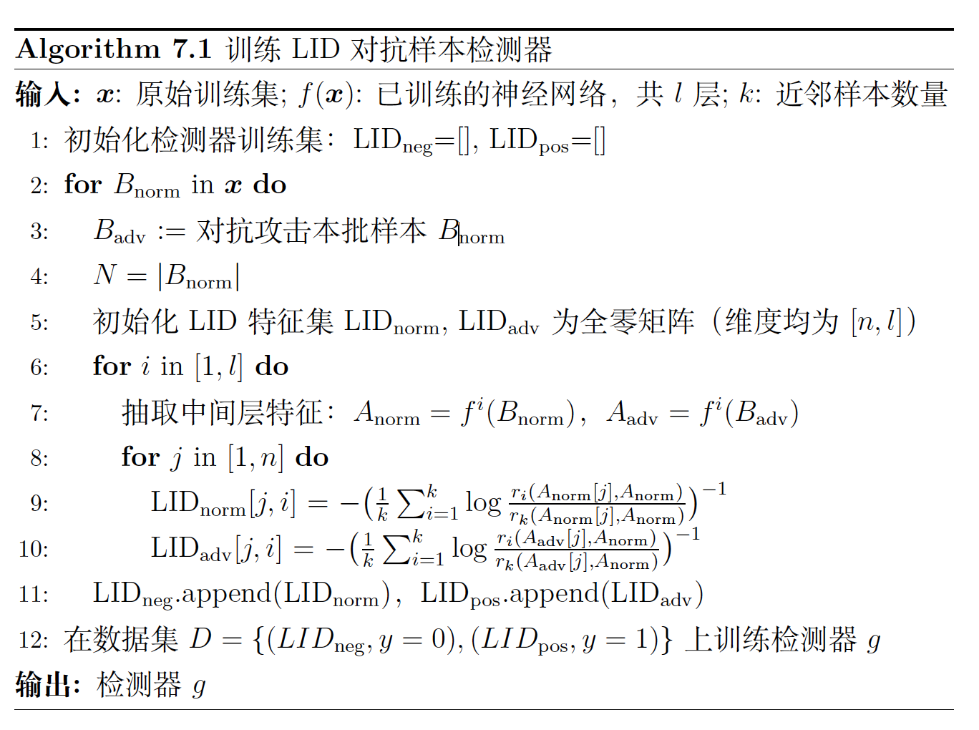
Local Intrinsic Dimensionality (LID)

Slide 33
Local Intrinsic Dimensionality (LID)
Experiments & Results:
Dataset | Feature | FGM | BIM-a | BIM-b | JSMA | Opt
MNIST | KD | 78.12 | 98.14 | 98.61 | 68.77 | 95.15
 | BU | 32.37 | 91.55 | 25.46 | 88.74 | 71.30
 | LID | 96.89 | 99.60 | 99.83 | 92.24 | 99.24
CIFAR-10 | KD | 64.92 | 68.38 | 98.70 | 85.77 | 91.35
 | BU | 70.53 | 81.60 | 97.32 | 87.36 | 91.39
 | LID | 82.38 | 82.51 | 99.78 | 95.87 | 98.94
SVHN | KD | 70.39 | 77.18 | 99.57 | 86.46 | 87.41
 | BU | 86.78 | 84.07 | 86.93 | 91.33 | 87.13
 | LID | 97.61 | 87.55 | 99.72 | 95.07 | 97.60
Characterizing Adversarial Subspace Using Local Intrinsic Dimensionality. Ma et al. ICLR 2018

Slide 34
Local Intrinsic Dimensionality (LID)
Experiments & Results:
Train \ Test attack |  | FGM | BIM-a | BIM-b | JSMA | Opt
FGSM | KD | 64.92 | 69.15 | 89.71 | 85.72 | 91.22
 | BU | 70.53 | 81.67 | 2.65 | 86.79 | 91.27
 | LID | 82.38 | 82.30 | 91.61 | 89.93 | 93.32
Detectors trained on simple attacks FGSM can detect complex attacks
Characterizing Adversarial Subspace Using Local Intrinsic Dimensionality. Ma et al. ICLR 2018

Slide 35
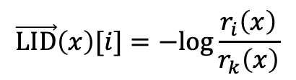
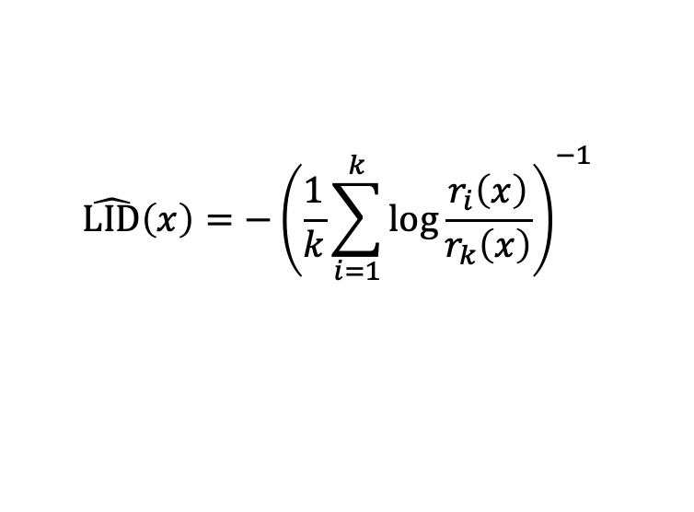
An Improved Detector of LID
$$\hat{LID}\left(x\right)=−{\left(\frac{1}{k}\sum_{i=1}^{k}{\log{\frac{r_{i}\left(x\right)}{r_{k}\left(x\right)}}}\right)}^{−1}$$
$$\vec{LID}\left(x\right)[i]=−log{\frac{r_{i}\left(x\right)}{r_{k}\left(x\right)}}$$
https://arxiv.org/pdf/2212.06776.pdf

Slide 36
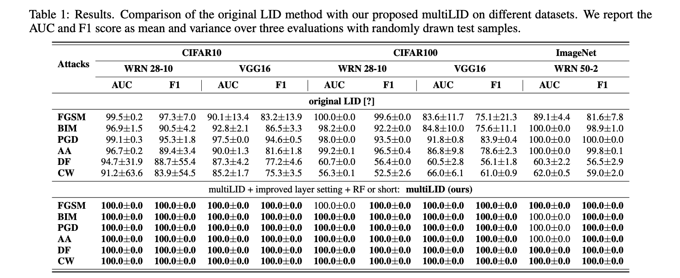
An Improved Detector of LID
https://arxiv.org/pdf/2212.06776.pdf

Slide 37
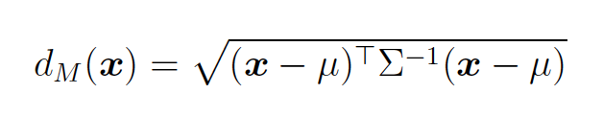
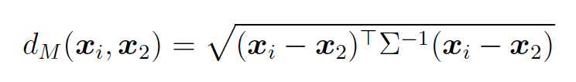

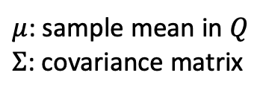
Mahalanobis Distance (MD)
The MD of a data point $x$ to a distribution $Q$:
$μ$: sample mean in $Q$
$Σ$: covariance matrix
The MD of between two data points:
Mahalanobis, Prasanta Chandra. "On the generalized distance in statistics." National Institute of Science of India, 1936.

Slide 38
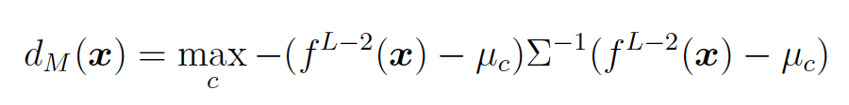
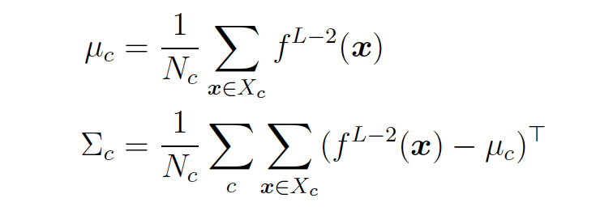
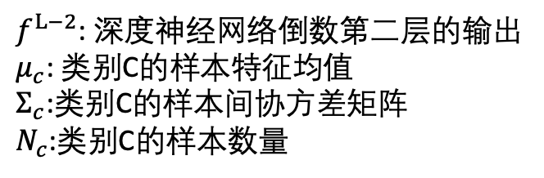
Mahalanobis Distance (MD)
Given a mode $f$ and training dataset $D$, the MD of a sample $x$ is defined as
$f^{L−2}$: 深度神经网络倒数第二层的输出
$μ_{c}$: 类别C的样本特征均值
$Σ_{c}$:类别C的样本间协方差矩阵
$N_{c}$:类别C的样本数量
Lee et al. “A simple unified framework for detecting out-of-distribution samples and adversarial attacks.” NeurIPS 2018.

Slide 39
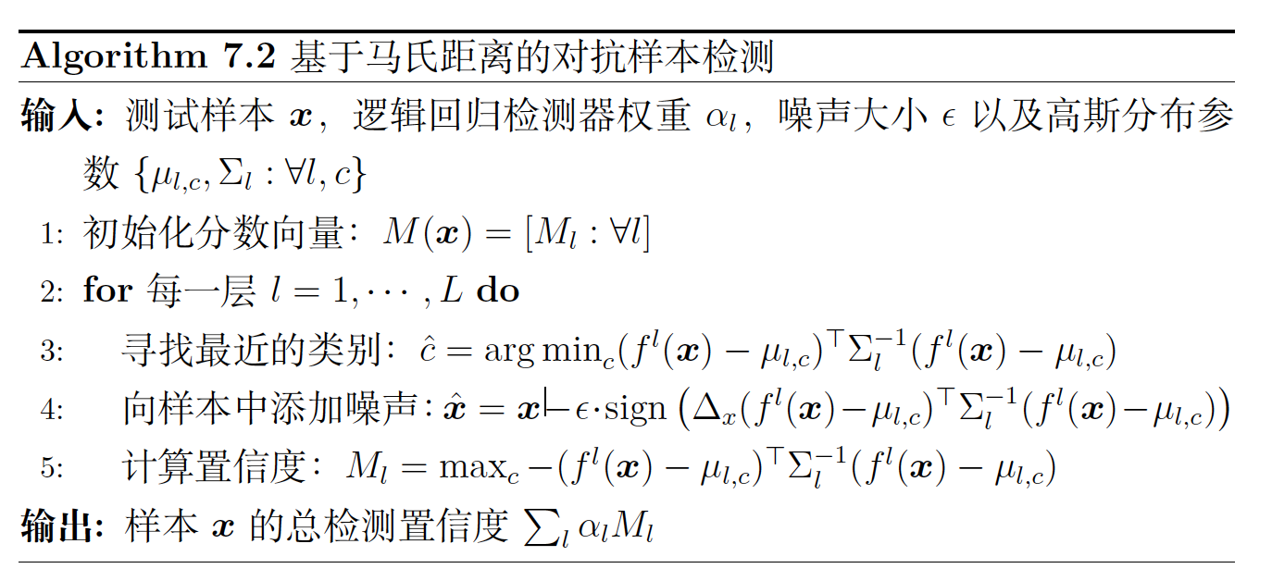
Mahalanobis Distance (MD)
Lee et al. “A simple unified framework for detecting out-of-distribution samples and adversarial attacks.” NeurIPS 2018.

Slide 40
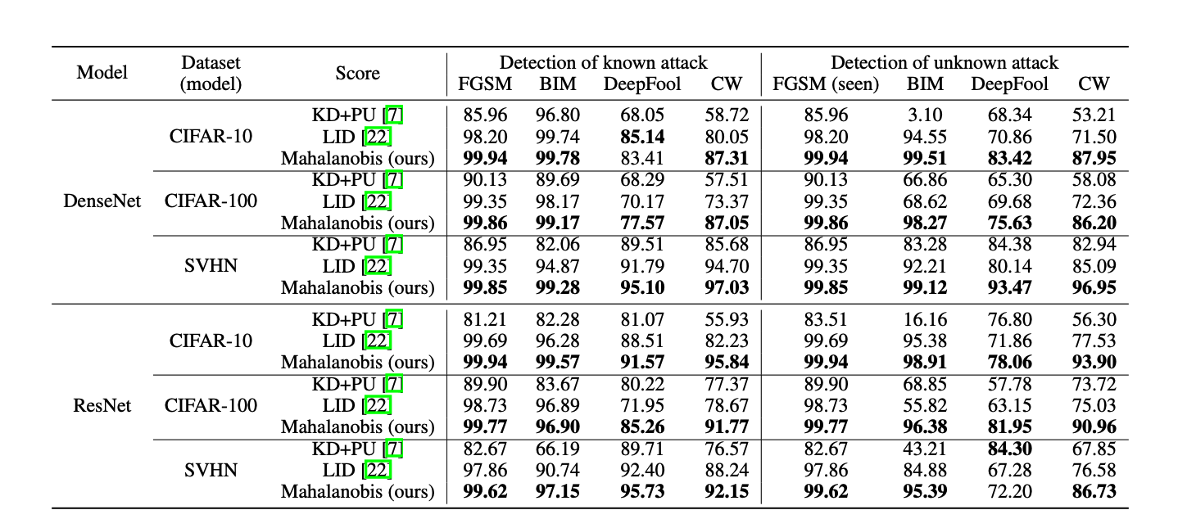
Mahalanobis Distance (MD)
Experiments & Results:
Lee et al. “A simple unified framework for detecting out-of-distribution samples and adversarial attacks.” NeurIPS 2018.

Slide 41
Existing Methods
Secondary Classification Methods (二级分类法)
Principle Component Analysis (主成分分析法，PCA)
Distribution Detection Methods (分布检测法)
Prediction Inconsistency (预测不一致性)
Reconstruction Inconsistency (重建不一致性)
Trapping Based Detection (诱捕检测法)

Slide 42
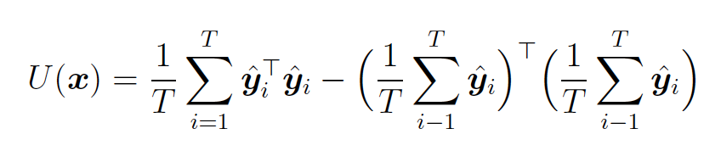
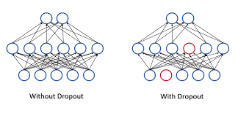
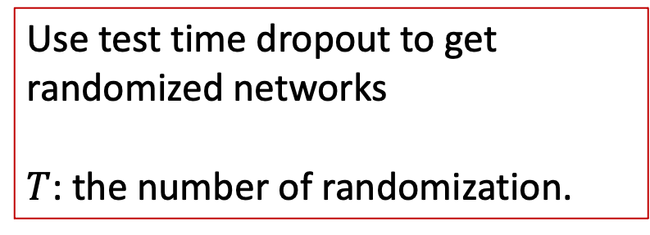
Bayes Uncertainty
Bayesian Uncertainty (BU)
Use test time dropout to get randomized networks
$T$: the number of randomization.
Feinman, Reuben, et al. "Detecting adversarial samples from artifacts." arXiv preprint arXiv:1703.00410 (2017).

Slide 43
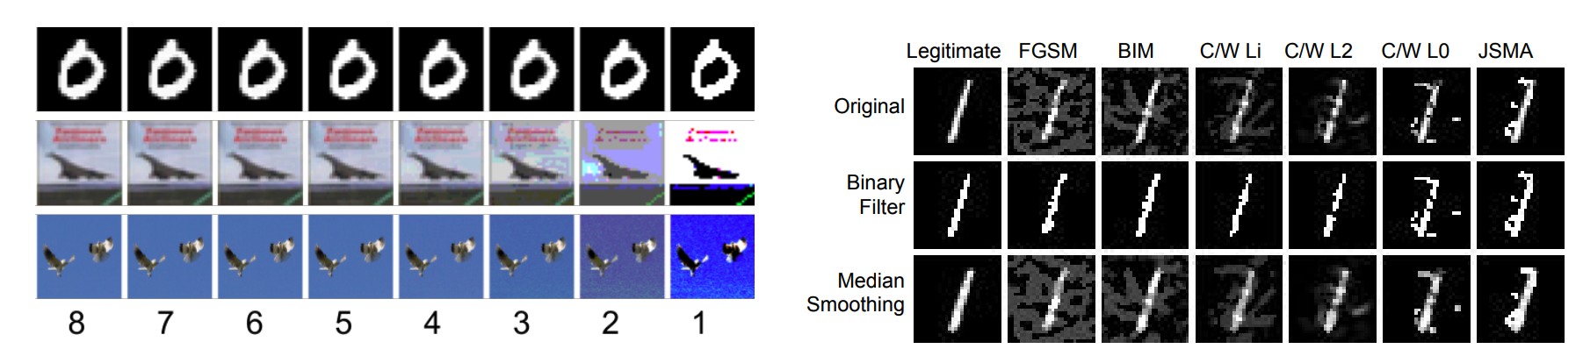
Feature Squeezing
Bit depth reduction
Squeezing clean and adv examples
Reducing input dimensionality improves robustness
The prediction inconsistency before and after squeezing can detect advs
Xu et al. "Feature squeezing: Detecting adversarial examples in deep neural networks." arXiv:1704.01155 (2017).

Slide 44
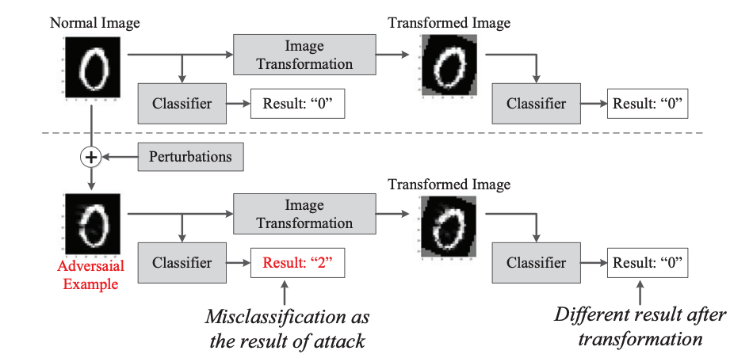
Random Transformation
The prediction of advs will change after random transformations
Tian et al. "Detecting adversarial examples through image transformation." AAAI 2018.

Slide 45
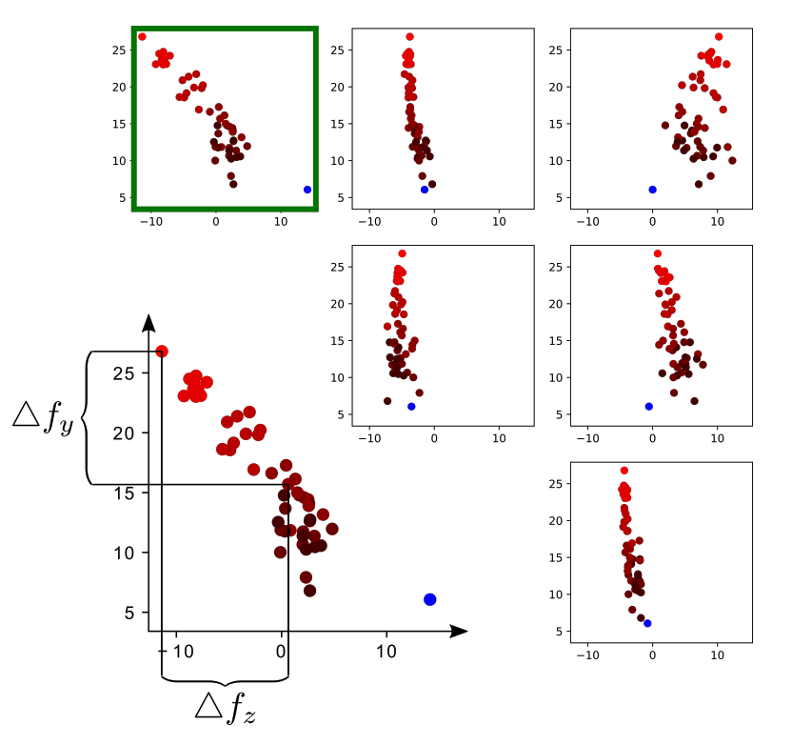



Log-Odds
$f_{y}$: 类别y对应的逻辑输出
$f_{z}$: 类别z对应的逻辑输出
蓝色点：原始样本
红色点：对抗样本
Add random noise to the input
$$x’ = x +η, η\sim 𝓝(μ,δ^{2})$$
$f\left(x′\right)≈f\left(x\right)$ ??
Roth et al. “The odds are odd: A statistical test for detecting adversarial examples.” ICML 2019.

Slide 46

Log-Odds
原则1：对抗样本的梯度更均匀
原则2：对抗样本难以被攻击第二次
测试准则1：随机噪声不会改变预测结果
测试准则1 ：再次攻击需要更多的扰动
Hu et al. “A new defense against adversarial images: Turning a weakness into a strength.” NeurIPS 2019.

Slide 47
Existing Methods
Secondary Classification Methods (二级分类法)
Principle Component Analysis (主成分分析法，PCA)
Distribution Detection Methods (分布检测法)
Prediction Inconsistency (预测不一致性)
Reconstruction Inconsistency (重建不一致性)
Trapping Based Detection (诱捕检测法)

Slide 48


Detector-Reformer
原则：对抗样本无法重建
AE: Autoencoder
E(x): reconstruction error
Meng, Dongyu, and Hao Chen. “Magnet: a two-pronged defense against adversarial examples”, SIGSAC 2019.

Slide 49

Detector-Reformer
How the reformer works?
绿色：正常样本
红色x：对抗样本
红色箭头：自编码器
Meng, Dongyu, and Hao Chen. “Magnet: a two-pronged defense against adversarial examples”, SIGSAC 2019.

Slide 50
Existing Methods
Secondary Classification Methods (二级分类法)
Principle Component Analysis (主成分分析法，PCA)
Distribution Detection Methods (分布检测法)
Prediction Inconsistency (预测不一致性)
Reconstruction Inconsistency (重建不一致性)
Trapping Based Detection (诱捕检测法)

Slide 51

Neural Fingerprinting (NFP)
Fingerprint is defined as:
Detect advs with N=2 fingerprints
Dathathri, Sumanth, et al. "Detecting adversarial examples via neural fingerprinting." arXiv:1803.03870 (2018).

Slide 52



Neural Fingerprinting (NFP)
How to verify the fingerprint?
$Δx_{i}$is class-independent noise
Dathathri, Sumanth, et al. "Detecting adversarial examples via neural fingerprinting." arXiv:1803.03870 (2018).

Slide 53

Benchmarking

Slide 54
谢谢！

